Slide 1


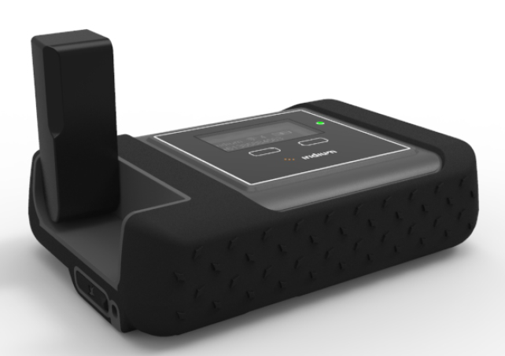
Iridium GO! Training

Slide 2
Agenda
Product Overview
  Key Features
  Positioning
  Tech Specs
  Use Options
  Accessories
  Applications
Target Markets
  Consumer
  Business
  Government
Pricing
  Pricing Resources
  Canadian Retail Pricing
Competitive Comparison
Service Activation Process
Device Configuration
Resources
  Customer quick start guide
  Tech Specs
  Sales Sheet
  Accessories Sales Sheet
  Device Comparison
  Data Usage Table
  Brochure
  Prepaid Pricing Tool

Slide 3
Iridium GO! Key Features
Feature | Description
Connectivity | Apple and Android devices will now work anywhere on the planet. The first ever reliable global voice and data connection with pole to pole Iridium coverage. Connects up to 5 mobile devices (single user at a time).
Simplicity | Simple and easy to use. No worries. No roaming charges.
Optimized | An all-in-one solution that supports: Voice calling SMS/text messaging Email GPS positioning Online tracking Emergency SOS
Ruggedized | Jet water resistant, shock resistant and dust proof (IP65 rated). Portable and chargeable with battery life of up to 5.5 hours.

Slide 4
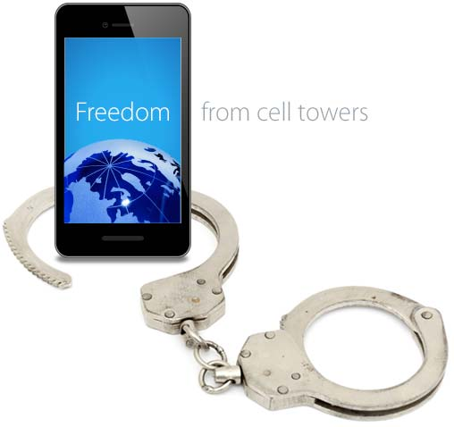
Iridium GO! Positioning
Versatile
Iridium GO! supports a full range of global communications, including:
Voice calls Email access Applications Social networking | Photo sharing SMS two-way GPS tracking SOS alerts
Simple
Easy to Use, stable, lay-flat design, flip up antenna and built-in menu/status display.
Mobile
Powered by the world's furthest reaching network, dramatically extend the capabilities of your personal devices by creating a reliable satellite connection – anywhere on the planet.
Innovative
It’s like having your very own global cell tower – only much easier to pack.
Affordable
Iridium GO! is an affordable solution for global connectivity, delivering remarkable value compared to other options.

Slide 5
Iridium GO! Tech Specs
Key technical specifications are listed below, more detailed specifications are available in the Iridium GO! Technical Specs Document.
Dimensions | 81.7 X 119.81 X 33.44 mm
Weight with Battery | 305 g
Ingress Protection (IP) | IP65
Temperature Ranges | -10C to +50C (Operational), -20C to +60C (Storage)
Wi-Fi Frequency & Range | up to 30.5 meters or 100 feet (2.4 Ghz b, g, n)
Included GO! Applications | Iridium GO! (Phone, SMS, SOS) Iridium GO! Mail & Web (Mail, Web, Weather)
# of Users | Up to 5 can connect with Iridium GO! app
Battery Specs | 3600 mAh providing up to 5.5 hrs talk time / up to 15.5 standby
Battery Charge Time | 4 hours
Interface Connectors | SIM, micro USB, External Antenna
External Antenna Adapter | TS-9 (TS-9 to TNC adapter available)

Slide 6




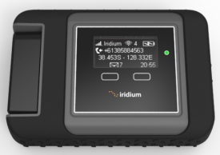

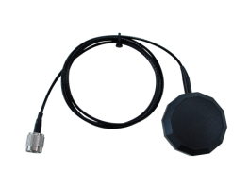


Iridium GO! Use Options
This hotspot device is portable and can be used in a variety of situations:
1
Portable
2
In-Vehicle
3
In-Building
For additional information on these configuration options, you can download the Iridium GO! Accessories Sales Sheet or refer to the Iridium GO! User Manual.

Slide 7
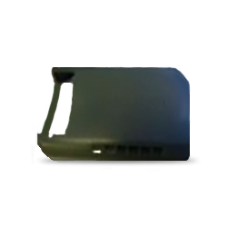
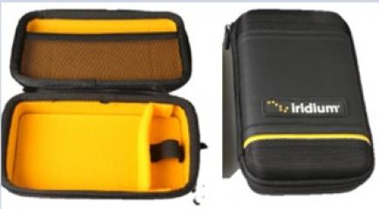
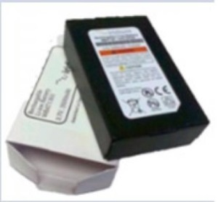

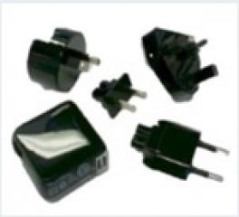
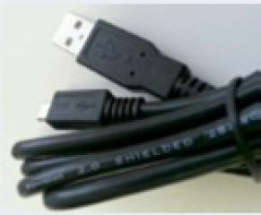
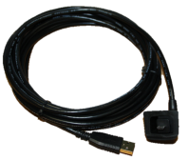
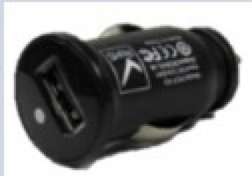

Iridium GO! Accessories
Iridium is launching a series of accessories specifically compatible with the Iridium GO!
Additional details and configurations can be found by referencing Roadpost’s Iridium GO! Accessories Sell Sheet.
Included Accessories:
Additional Accessories:
Carry Bag with carabiner
Protective
Cover
Battery
Wall Mount
AC Adapter Kit
USB Cable
5m Outdoor USB Cable
DC Auto Adapter
External Antenna Adapter

Slide 8


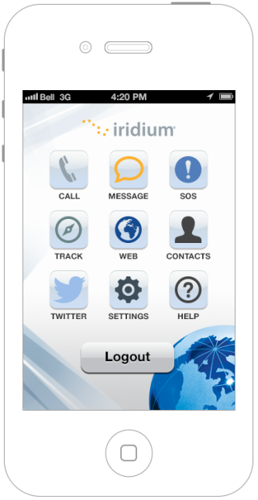
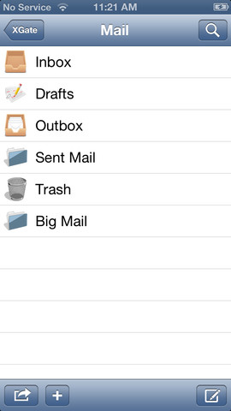


Iridium GO! Applications
Iridium GO! and Iridium GO! Mail & Web Apps will be available for download in iTunes and Google Play storefronts.
These apps are required to connect to your Iridium GO!
Iridium GO! App | Iridium GO! Mail & Web App
Apple iOS and Android Multiple Users (up to 5) Settings Phone calling & transfer Text messaging SOS button Tracking Twitter Contact Management In-App Help | Apple iOS and Android E-mail: <name>@my.iridium.net External account sync Compression Social media updates Weather In-App Help

Slide 9
Target Markets: Consumer
Segment | Value Proposition
Boaters | In shore and off shore boaters (25-60ft wind and gas), mostly weekend users who cannot live without connection (text, email and calls) to friends, family and work over a weekend. Obtain weather data, wind and currents.
Explorers | Weekend warriors: Hiker, biker, campers who are weekend warriors in their own backyard but travel out of terrestrial wireless coverage. Expedition and Outfitters: Serious vacation or longer time period adventurers.
Rural Residents | Small remote housing, outfitter or work installations offering basic email and phone calling capability.
Travelers | Retired Adventurers: Large numbers of Baby boomers are taking to the road in small RVs and exploring their own country’s. Cruise Ship Passengers: Call home and email without cost or hassle of visiting Internet Café.

Slide 10
Target Markets: Business
Segment | Value Proposition
Offices in Disaster-Prone Areas | Low cost option to enable businesses to connect in event of disaster. Can be installed or carried, increasing utility. Example locations include US Gulf, Japan, etc.
Expedition Leaders | Enable expedition leader to share and manage connection with customers who will value being able to connect to home and pay the expedition leader for usage.
Executive Roamers | Iridium is less expensive than roaming onto another carrier’s network ($2.50 vs $1.50) as long as large emails are not required.
Truckers | Truckers whose companies require productivity applications, such as dispatch, email or voice communications with the driver. In addition, vehicular monitoring can be accommodated with a smartphone or Tablet.
Pilots | Small aircraft/bush pilots require weather updates, navigation, DUATs and other aviation related data transfers in addition to email and voice communications while out of terrestrial coverage.

Slide 11
Target Markets: Government
Segment | Value Proposition
Provincial/ Local/ Federal Disaster Preparation | Connect to home country using own smartphone but with Iridium network for improved security (calls bypass local landlines).
Military | Welfare calling at forward operating bases and for rapid deployments so soldiers can stay connected to home (ex. like DoD).
State Department/Diplomats | Connect to home country using own smartphone but with Iridium network for improved security (calls bypass local landlines).
Special Operations | Important to have device that allows them to inconspicuously use their own smartphones to blend in (ex. hide and use own smartphone).

Slide 12
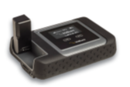
Hardware & Prepaid Pricing
Prepaid Pricing Terms:
Minimum call duration is 20 seconds. Airtime included is estimated based on burn rates for popular usage types. The maximum expiry period per account is two (2) years. Ask your dealer for details.
Airtime included is estimated based on burn rates. Usage types can be combined and will be deducted accordingly.
Iridium GO! prepaid card types can be recharged prior to expiry by using the Iridium GO! 30 day add-time voucher or by purchasing an Iridium GO! Seasonal or Annual recharge. Both unused minutes and the remaining expiry period carry forward when the card is recharged. Expiry dates are cumulative.
Iridium Canada/ Alaska Cards can be recharged prior to expiry by purchasing an Iridium Canada/ Alaska recharge voucher. Expiry dates are not cumulative (i.e. balance is always 6 months from the activation or recharge date).
Remaining minute balances will continue to carry forward until the balance expires. The Canada/Alaska coverage region includes the Canada and Alaska plus 12 nautical miles into coastal waters.
GO! Dealer sell sheet
Dealer Price list

Slide 13
Postpaid Pricing
Contract-free plans exclusively from Roadpost.
All plans include voice, data and SMS
Free voicemail, call display and incoming calls/SMS
Cancel, switch or suspend your plan any time without penalties!
Plans from $55.99/month
Unlimited data and SMS for just $139.99/month
Pricing Details:
GO! Dealer sell sheet
Postpaid pricing terms:
There is no term commitment for the Iridium GO! postpaid subscriptions beyond the initial 30-day commitment. A one-time activation fee of $35 applies to all plans. Plans renew automatically month-to-month until cancelled. Pooled voice minutes means that you can share airtime with other users on your account. Data can also be pooled among users of the Iridium GO! 10 and Iridium GO! 100 plans only. SMS messages cannot be pooled. Unused airtime does not carry forward month-to-month. Airtime is billed per minute in 60 second increments, except SMS which is billed per message. Plans are subject to change at any time. Subject to Roadpost Standard Terms and Conditions.

Slide 14
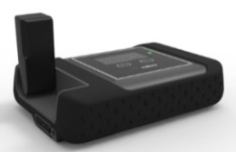
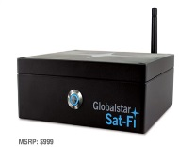
Mobile Data Product Comparison
 | Iridium GO! | IsatHub | Sat-Fi
Network | Iridium LEO | Geostationary | Globalstar LEO
Image
Coverage | 100% pole to pole global coverage | Nearly global coverage | US and Southern Canada
Features | Voice Calls, SMS, Email & Web SOS Emergency Button & GPS, Weather, Social Network | Voice, SMS, data SmartApp, iOS & Android Multiple user support | Voice Calls Email Web GPS Positioning
Restrictions | Not IP Lower data speeds Requires optimised apps | Not recommended to use while moving No tracking | SOS button and SMS functionality not available at launch No internal battery, requires connectivity to power source
Mobility | Works stationary or on the move | Requires steady connection to satellite constellation | In-vehicle, requires connectivity to power source
Data speeds | Circuit Switched 2.4kbps and up to 9.6 kbps with Web & Mail app | Real-time IP data 384/240kbps | Up to 9.6 Kbps
Multi-user | Yes, up to 5 | Yes | Yes, up to 8 users
Size/weight | 114 x 82 x 32 mm - 305g | 179 x 170 x 30 mm - 850g | 160 x 160 x 61 mm
IP rating | IP65 | N/A | IP4
Dev. platform | Yes | Yes | No

Slide 15
Service Activation Process
Steps | Process Details
Submit Service Activation Request | Select prepaid or postpaid SIM depending on service selected by customer. For prepaid activations, contact Partner Support (as per the usual process). For postpaid activations, submit the Iridium GO! Postpaid Activation Form which will automatically notify the Roadpost Partner Support Team. Before you start completing the postpaid form, please ensure you have the following information: Your Dealer account number. Customer information to create new Roadpost account. Customer payment information (if paying by credit card, you will be required to provide this information to Partner Support via phone). List of Iridium GO! IMEIs you are activating. List of Iridium GO! postpaid SIM cards you are activating. Knowledge of which postpaid service plans you wish to activate.
Confirm Activation | Once the account is created and services are added, the account owner (the customer for postpaid and the dealer for prepaid) will receive a notification from the Roadpost that the order is complete.

Slide 16
Iridium GO! Device Configuration
To simplify the customer onboarding experience, Roadpost has created an Iridium GO! Customer Quick Start Guide. A high level summary is provided below:
Steps | Process Details
Download Iridium GO! and Iridium GO! Web & Mail Apps | Download the Iridium GO! and Iridium GO! Mail & Web Apps from the Google Play Store (Android) or iTunes (Apple iOS). For compressed email and web browsing, use of the Iridium Mail & Web application is required. Register at www.iridium.com/mailandweb. From the Iridium GO! Mail & Web app, the customer will configure their email service. Additional details can be found in the Iridium GO! User Manual.
Register GEOS | To enable the SOS button on both the Iridium GO! device as well as in the Iridium GO! app, the customer must first register with GEOS Alliance at www.geosalliance.com/iridium. To complete the registration, the customer will require the following: Iridium GO! service number, SIM card number and device IMEI. Customer’s contact info, country and citizenship. Primary and secondary emergency contact information. Additional medical information . GEOS to send authorization code which must be entered into the Iridium GO! app.

